Slide 1

WELCOME

Slide 2
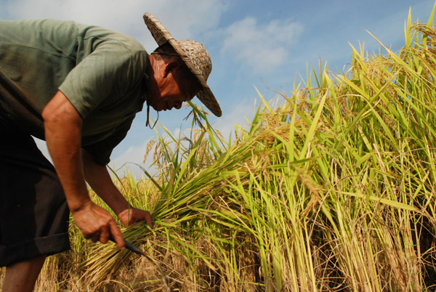
The farmer will have cut paddy by this time

Slide 3
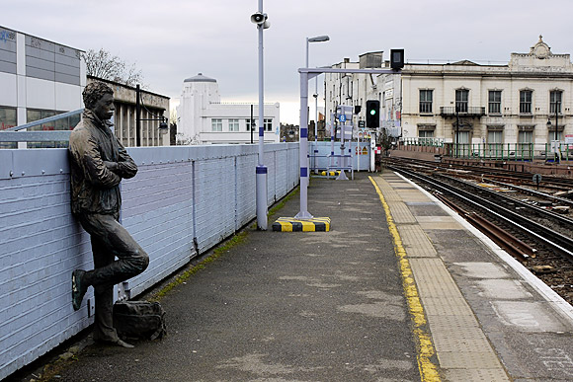
He will have reached the station by this time.

Slide 4
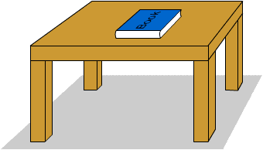
Future perfect tense
I shall have finished reading the book by this time

Slide 5

The students will have reached school before the class starts

Slide 6
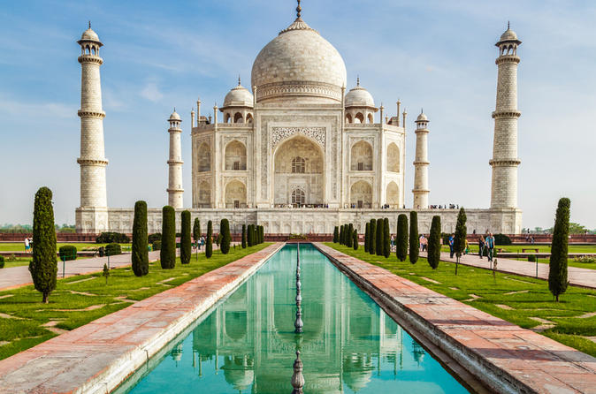
They will have visited the Taj mahal by this time

Slide 7

The boy will have written a letter by this time

Slide 8
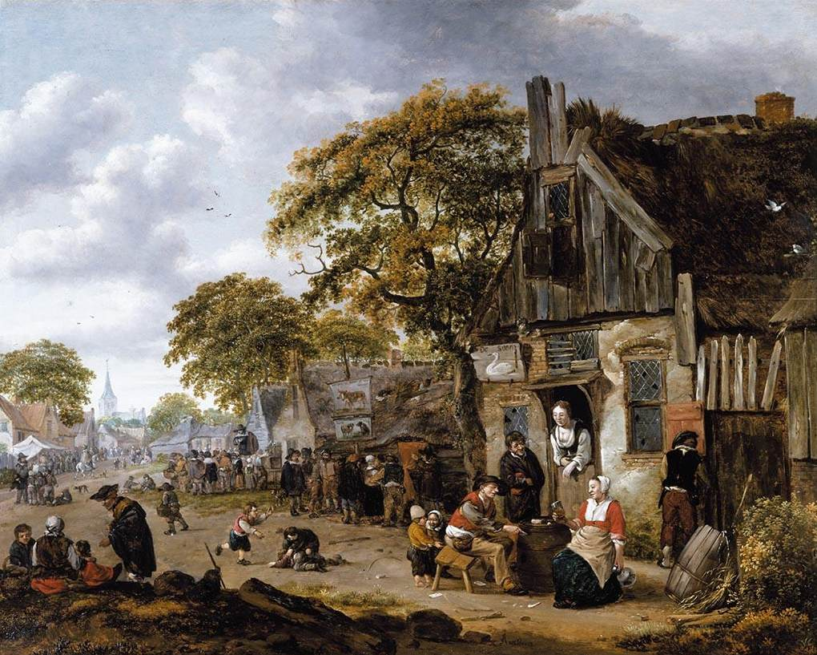

The villagers will have woke up after the sun rises

Slide 9
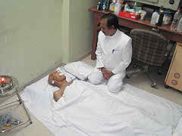
The patient will have died after the doctor comes

Slide 10
Future perfect tense denotes an action that will be completed at some point of time in future;
STRUCTURE
Subj+shall have/will have(AV)+PV(past participle)+obj/OE.
1.Subj+shall have/will have(AV)+PV(past participle)+before+present indefinite tense.
2.Subj+shall have/will have(AV)+PV(past participle)+after+ present indefinite tense
3.Future perfect tense+ time/OE.

Slide 11
EVALUATION
Fill in the gaps with the right form of verbs of the future perfect tense;
1.Mr. Rahim------a house nezt year(build)
2.He --------before you finish the work.(return)
3.Kamal----the market by this time.(reach)
4.Hena-----the sum after I return home.(do)
5.My mother------reading the holy Quran by this time. ((finish)
THANK YOU

